Slide 1

Design Azure application
Session 04

Slide 2
AGENDA
Design for Scalability
Design for High Availability
Design for Resilience
Design for Data
Design for Messaging
Design for Management and Monitoring
Design for Security

Slide 3
Design to scale out
A primary advantage of the cloud is elastic scaling — the ability to use as much capacity as you need, scaling out as load increases, and scaling in when the extra capacity is not needed.
Design your application so that it can scale horizontally, adding or removing new instances as demand requires.

Slide 4
Design to scale out-Recommendations
Avoid instance stickiness.
Identify bottlenecks.
Decompose workloads by scalability requirements
Offload resource-intensive tasks
Use built-in autoscaling features
Consider aggressive autoscaling for critical workloads.

Slide 5
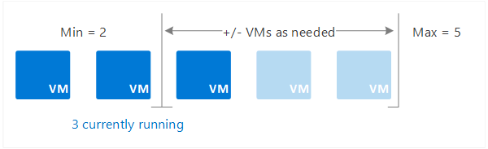
Recommendations

Slide 6
Design for Availability & Self healing
In a distributed system, failures can happen. Hardware can fail. The network can have transient failures. Rarely, an entire service or region may experience a disruption, but even those must be planned for.
Therefore, design an application to be self healing when failures occur. This requires a three-pronged approach:
Detect failures.
Respond to failures gracefully.
Log and monitor failures, to give operational insight.

Slide 7
Recommendations
Retry failed operations. Transient failures may occur due to momentary loss of network connectivity, a dropped database connection, or a timeout when a service is busy. Build retry logic into your application to handle transient failures.
Retry failed operations. Transient failures may occur due to momentary loss of network connectivity, a dropped database connection, or a timeout when a service is busy. Build retry logic into your application to handle transient failures.

Slide 8
Recommendations
Isolate critical resources (Bulkhead). Failures in one subsystem can sometimes cascade. This can happen if a failure causes some resources, such as threads or sockets, not to get freed in a timely manner, leading to resource exhaustion. To avoid this, partition a system into isolated groups, so that a failure in one partition does not bring down the entire system.
Perform load leveling. Applications may experience sudden spikes in traffic that can overwhelm services on the backend. To avoid this, use the Queue-Based Load Leveling pattern to queue work items to run asynchronously. The queue acts as a buffer that smooths out peaks in the load.

Slide 9
Recommendations
Fail over. If an instance can't be reached, fail over to another instance. For things that are stateless, like a web server, put several instances behind a load balancer or traffic manager. For things that store state, like a database, use replicas and fail over. Depending on the data store and how it replicates, this may require the application to deal with eventual consistency.
Compensate failed transactions. In general, avoid distributed transactions, as they require coordination across services and resources. Instead, compose an operation from smaller individual transactions. If the operation fails midway through, use Compensating Transactions to undo any step that already completed.

Slide 10
Recommendations
Degrade gracefully. Sometimes you can't work around a problem, but you can provide reduced functionality that is still useful. Consider an application that shows a catalog of books. If the application can't retrieve the thumbnail image for the cover, it might show a placeholder image. Entire subsystems might be noncritical for the application. For example, in an e-commerce site, showing product recommendations is probably less critical than processing orders.

Slide 11
Design for Resilience
A resilient application routes around failure. Identify the critical paths in your application. Is there redundancy at each point in the path? When a subsystem fails, will the application fail over to something else?

Slide 12
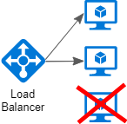
Recommendations
Place VMs behind a load balancer. Don't use a single VM for mission-critical workloads. Instead, place multiple VMs behind a load balancer. If any VM becomes unavailable, the load balancer distributes traffic to the remaining healthy VMs.

Slide 13
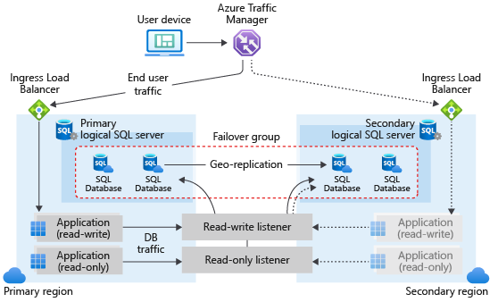
Recommendations
Enable geo-replication. Geo-replication for Azure SQL Database and Cosmos DB creates secondary readable replicas of your data in one or more secondary regions. In the event of an outage, the database can fail over to the secondary region for writes.

Slide 14
Recommendations
Replicate databases. Azure SQL Database and Cosmos DB automatically replicate the data within a region, and you can enable geo-replication across regions.
Partition for availability. Database partitioning is often used to improve scalability, but it can also improve availability. If one shard goes down, the other shards can still be reached. A failure in one shard will only disrupt a subset of the total transactions.

Slide 15
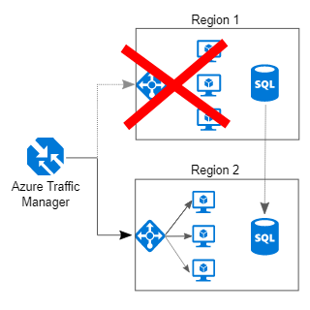
Recommendations
Deploy to more than one region. For the highest availability, deploy the application to more than one region. That way, in the rare case when a problem affects an entire region, the application can fail over to another region.

Slide 16
Recommendations
Include redundancy for Traffic Manager. Traffic Manager is a possible failure point. Review the Traffic Manager SLA, and determine whether using Traffic Manager alone meets your business requirements for high availability. If not, consider adding another traffic management solution as a failback

Slide 17
Design for Data
Traditional RDBMS workloads. These workloads include online transaction processing (OLTP) and online analytical processing (OLAP). Data in OLTP systems is typically relational data with a predefined schema and a set of constraints to maintain referential integrity. Often, data from multiple sources in the organization may be consolidated into a data warehouse, using an ETL process to move and transform the source data.

Slide 18
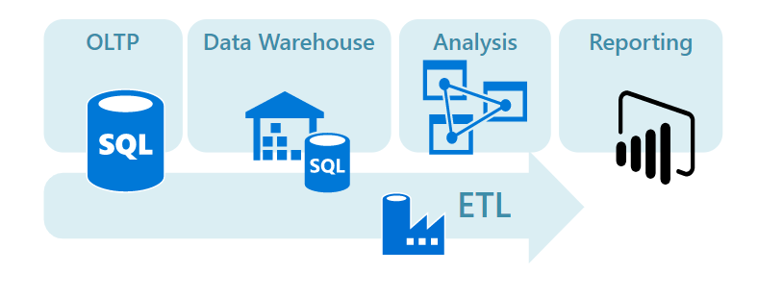
Design for Data

Slide 19
Design for Data
Big data solutions. A big data architecture is designed to handle the ingestion, processing, and analysis of data that is too large or complex for traditional database systems. The data may be processed in batch or in real time.
Big data solutions typically involve a large amount of non-relational data, such as key-value data, JSON documents, or time series data. Often traditional RDBMS systems are not well-suited to store this type of data.
The term NoSQL refers to a family of databases designed to hold non-relational data. The term isn't quite accurate, because many non-relational data stores support SQL compatible queries. The term NoSQL stands for "Not only SQL".

Slide 20
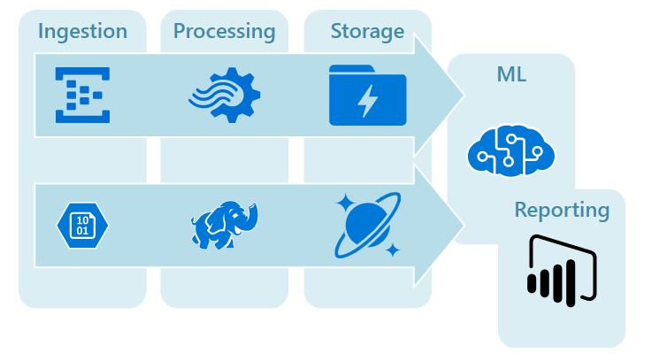
Design for Data

Slide 21
Design for Messaging
The distributed nature of cloud applications requires a messaging infrastructure that connects the components and services, ideally in a loosely coupled manner in order to maximize scalability.
Asynchronous messaging is widely used, and provides many benefits, but also brings challenges such as the ordering of messages, poison message management, idempotency, and more.

Slide 22
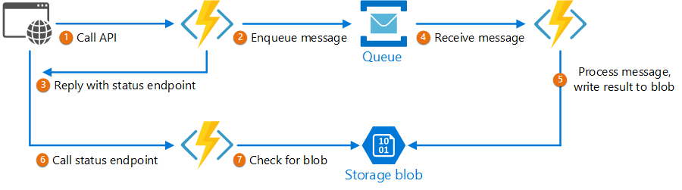
Asynchronous Request-Reply pattern
Decouple backend processing from a frontend host, where backend processing needs to be asynchronous, but the frontend still needs a clear response.

Slide 23
Design for Messaging
Claim Check | Split a large message into a claim check and a payload to avoid overwhelming a message bus.
Choreography | Have each component of the system participate in the decision-making process about the workflow of a business transaction, instead of relying on a central point of control.
Competing Consumers | Enable multiple concurrent consumers to process messages received on the same messaging channel.
Pipes and Filters | Break down a task that performs complex processing into a series of separate elements that can be reused.
Priority Queue | Prioritize requests sent to services so that requests with a higher priority are received and processed more quickly than those with a lower priority.
Publisher-Subscriber | Enable an application to announce events to multiple interested consumers asynchronously, without coupling the senders to the receivers.
Queue-Based Load Leveling | Use a queue that acts as a buffer between a task and a service that it invokes in order to smooth intermittent heavy loads.
Scheduler Agent Supervisor | Coordinate a set of actions across a distributed set of services and other remote resources.
Sequential Convoy | Process a set of related messages in a defined order, without blocking processing of other groups of messages.

Slide 24
Design for Management and Monitoring
Application-centric platform monitoring, encompassing both hot and cold telemetry paths for metrics and logs, respectively:
Operating system metrics; for example, performance counters and custom metrics
Operating system logs; for example, Internet Information Services, Event Tracing for Windows, and syslog
Resource health events

Slide 25
Design for Management and Monitoring
Security audit logging and achieving a horizontal security lens across your organization's entire Azure estate:
Potential integration with on-premises security information and event management (SIEM) systems such as ServiceNow, ArcSight, or the Onapsis security platform
Azure activity logs
Azure Active Directory (Azure AD) audit reports
Azure diagnostic services, logs, and metrics; Azure Key Vault audit events; network security group (NSG) flow logs; and event logs
Azure Monitor, Azure Network Watcher, Azure Security Center, and Azure Sentinel

Slide 26
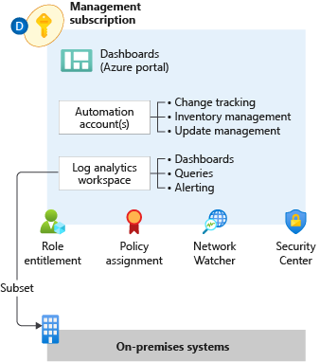
Design for Management and Monitoring

Slide 27
Design for Security
Align Security Priorities to Mission – Security resources are almost always limited, so prioritize efforts and assurances by aligning security strategy and technical controls to the business using classification of data and systems. Security resources should be focused first on people and assets (systems, data, accounts, etc.) with intrinsic business value and those with administrative privileges over business critical assets.

Slide 28
Design for Security
Build a Comprehensive Strategy – A security strategy should consider investments in culture, processes, and security controls across all system components. The strategy should also consider security for the full lifecycle of system components including the supply chain of software, hardware, and services.

Slide 29
Design for Security
Drive Simplicity – Complexity in systems leads to increased human confusion, errors, automation failures, and difficulty of recovering from an issue. Favor simple and consistent architectures and implementations.

Slide 30
Design for Security
Design for Attackers – Your security design and prioritization should be focused on the way attackers see your environment, which is often not the way IT and application teams see it. Inform your security design and test it with penetration testing to simulate one-time attacks. Use red teams to simulate long-term persistent attack groups.

Slide 31
Design for Security
Leverage Native Controls – Favour native security controls built into cloud services over external controls from third parties. Native security controls are maintained and supported by the service provider, eliminating or reducing effort required to integrate external security tooling and update those integrations over time.

Slide 32
Design for Security
Use Identity as Primary Access Control – Access to resources in cloud architectures is primarily governed by identity-based authentication and authorization for access controls. Your account control strategy should rely on identity systems for controlling access rather than relying on network controls or direct use of cryptographic keys.

Slide 33
Thank You
Q & A

